Slide 1

Apex Institute of Technology
Department of Computer Science & Engineering
Data Mining and Warehousing
(CSF-334)
Dr Neha Agarwal
E11231
Assistant Professor
CSE(AIT), CU
DISCOVER . LEARN . EMPOWER

Slide 2
Contents to be Covered
Decision Tree
Overfitting in Classification

Slide 3
Classification by Decision Tree Induction
Decision tree
A flow-chart-like tree structure
Internal node denotes a test on an attribute
Branch represents an outcome of the test
Leaf nodes represent class labels or class distribution
Decision tree generation consists of two phases
Tree construction
At start, all the training examples are at the root
Partition examples recursively based on selected attributes
Tree pruning
Identify and remove branches that reflect noise or outliers
Use of decision tree: Classifying an unknown sample
Test the attribute values of the sample against the decision tree

Slide 4
Training Dataset
This follows an example from Quinlan’s ID3

Slide 5
Output: A Decision Tree for “buys_computer”
age?
<=30
overcast
>40
30..40
student?
yes
credit rating?
no
yes
excellent
fair
no
yes
no
yes

Slide 6
Algorithm for Decision Tree Induction
Basic algorithm (a greedy algorithm)
Tree is constructed in a top-down recursive divide-and-conquer manner
At start, all the training examples are at the root
Attributes are categorical (if continuous-valued, they are discretized in advance)
Examples are partitioned recursively based on selected attributes
Test attributes are selected on the basis of a heuristic or statistical measure (e.g., information gain)
Conditions for stopping partitioning
All samples for a given node belong to the same class
There are no remaining attributes for further partitioning – majority voting is employed for classifying the leaf
There are no samples left

Slide 7
Attribute Selection Measure
Information gain (ID3/C4.5)
All attributes are assumed to be categorical
Can be modified for continuous-valued attributes
Gini index (IBM IntelligentMiner)
All attributes are assumed continuous-valued
Assume there exist several possible split values for each attribute
May need other tools, such as clustering, to get the possible split values
Can be modified for categorical attributes

Slide 8
Information Gain (ID3/C4.5)
Select the attribute with the highest information gain
Assume there are two classes, P and N
Let the set of examples S contain p elements of class P and n elements of class N
The amount of information, needed to decide if an arbitrary example in S belongs to P or N is defined as

Slide 9
Information Gain in Decision Tree Induction
Assume that using attribute A a set S will be partitioned into sets {S₁, S₂ , …, S_{v}}
If S_{i} contains p_{i} examples of P and n_{i} examples of N, the entropy, or the expected information needed to classify objects in all subtrees S_{i} is
The encoding information that would be gained by branching on A

Slide 10
Attribute Selection by Information Gain Computation
Hence
Similarly
Class P: buys_computer = “yes”
Class N: buys_computer = “no”
I(p, n) = I(9, 5) =0.940
Compute the entropy for age:

Slide 11
Gini Index (IBM IntelligentMiner)
If a data set T contains examples from n classes, gini index, gini(T) is defined as
where p_{j} is the relative frequency of class j in T.
If a data set T is split into two subsets T₁ and T₂ with sizes N₁ and N₂ respectively, the gini index of the split data contains examples from n classes, the gini index gini(T) is defined as
The attribute provides the smallest gini_{split}(T) is chosen to split the node (need to enumerate all possible splitting points for each attribute).

Slide 12
Extracting Classification Rules from Trees
Represent the knowledge in the form of IF-THEN rules
One rule is created for each path from the root to a leaf
Each attribute-value pair along a path forms a conjunction
The leaf node holds the class prediction
Rules are easier for humans to understand
Example
IF age = “<=30” AND student = “no” THEN buys_computer = “no”
IF age = “<=30” AND student = “yes” THEN buys_computer = “yes”
IF age = “31…40” THEN buys_computer = “yes”
IF age = “>40” AND credit_rating = “excellent” THEN buys_computer = “yes”
IF age = “<=30” AND credit_rating = “fair” THEN buys_computer = “no”

Slide 13
Avoid Overfitting in Classification
The generated tree may overfit the training data
Too many branches, some may reflect anomalies due to noise or outliers
Result is in poor accuracy for unseen samples
Two approaches to avoid overfitting
Prepruning: Halt tree construction early—do not split a node if this would result in the goodness measure falling below a threshold
Difficult to choose an appropriate threshold
Postpruning: Remove branches from a “fully grown” tree—get a sequence of progressively pruned trees
Use a set of data different from the training data to decide which is the “best pruned tree”

Slide 14
Approaches to Determine the Final Tree Size
Separate training (2/3) and testing (1/3) sets
Use cross validation, e.g., 10-fold cross validation
Use all the data for training
but apply a statistical test (e.g., chi-square) to estimate whether expanding or pruning a node may improve the entire distribution
Use minimum description length (MDL) principle:
halting growth of the tree when the encoding is minimized

Slide 15
Enhancements to basic decision tree induction
Allow for continuous-valued attributes
Dynamically define new discrete-valued attributes that partition the continuous attribute value into a discrete set of intervals
Handle missing attribute values
Assign the most common value of the attribute
Assign probability to each of the possible values
Attribute construction
Create new attributes based on existing ones that are sparsely represented
This reduces fragmentation, repetition, and replication

Slide 16
Classification in Large Databases
Classification—a classical problem extensively studied by statisticians and machine learning researchers
Scalability: Classifying data sets with millions of examples and hundreds of attributes with reasonable speed
Why decision tree induction in data mining?
relatively faster learning speed (than other classification methods)
convertible to simple and easy to understand classification rules
can use SQL queries for accessing databases
comparable classification accuracy with other methods

Slide 17
Scalable Decision Tree Induction Methods in Data Mining Studies
SLIQ (EDBT’96 — Mehta et al.)
builds an index for each attribute and only class list and the current attribute list reside in memory
SPRINT (VLDB’96 — J. Shafer et al.)
constructs an attribute list data structure
PUBLIC (VLDB’98 — Rastogi & Shim)
integrates tree splitting and tree pruning: stop growing the tree earlier
RainForest (VLDB’98 — Gehrke, Ramakrishnan & Ganti)
separates the scalability aspects from the criteria that determine the quality of the tree
builds an AVC-list (attribute, value, class label)

Slide 18
Data Cube-Based Decision-Tree Induction
Integration of generalization with decision-tree induction (Kamber et al’97).
Classification at primitive concept levels
E.g., precise temperature, humidity, outlook, etc.
Low-level concepts, scattered classes, bushy classification-trees
Semantic interpretation problems.
Cube-based multi-level classification
Relevance analysis at multi-levels.
Information-gain analysis with dimension + level.

Slide 19
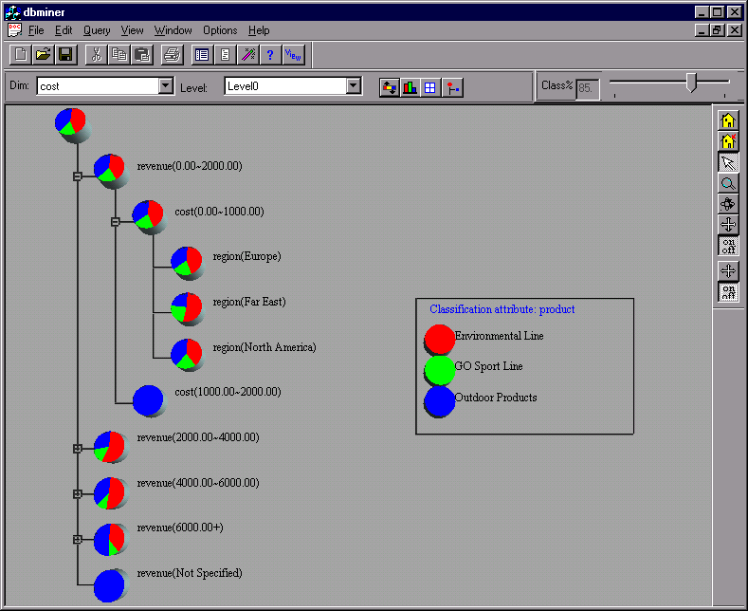
Presentation of Classification Results

Slide 20
Homework
Explain the steps of decision tree generation?
Discuss Methods of avoiding overfitting?

Slide 21
References
TEXT BOOKS
Introduction to Data Mining, Tan, Steinbach and Vipin Kumar, Pearson Education, 2016
REFERENCE BOOKS
Data Mining: Concepts and Techniques, Pei, Han and Kamber, Elsevier (2nd edition)
Journals
https://www.sciencedirect.com/topics/computer-science/data-generalization

Slide 22
Thank you
Please Send Your Queries on:
e-Mail: neha.e11231@cumail.in

